Slide 1
Primes is in P
Manindra Agrawal, Neeraj Kayal and Nitin Saxena
August 6, 2002
Presenter: Yung-Hsing Peng
Date: Jan. 7, 2005

Slide 2
Abstract
We present a deterministic polynomial-time algorithm that determines whether an input number n is prime or composite.
“The problem of distinguishing prime numbers from composite numbers and of resolving the latter into their prime factors is known to be one of the most important and useful in arithmetic. It has engaged the industry and wisdom of ancient and modern geometers to such an extent that it would be superfluous to discuss the problem at length... Further, the dignity of the science itself seems to require that every possible means be explored for the solution of a problem so elegant and so celebrated.“
- Karl Friedrich Gauss, Disquisitiones Arithmeticae, 1801

Slide 3
List of Time Complexity
The Sieve of Eratosthenes (ca. 240 BC)
Ω(n) where n is input number
Adleman, Pomerance, and Rumely (1983)
Deterministic algorithms runs in (log n)^{O(log log log n)}
Manindra Agrawal, Neeraj Kayal and Nitin Saxena (2002)
Deterministic algorithms runs in O((log n)¹²) (AKS Algorithm)
Others: randomized algorithms

Slide 4

Basic Idea of AKS Algorithm
Identity: Suppose that a is coprime to p. Then p is prime if and only if
(time infeasible)
Modified in AKS
(time feasible)

Slide 5
Improvement
Under this modification, coefficients and degree in this testing formula are limited.
However, some special composite p will also pass this test.→ conquer these special cases in advance

Slide 6
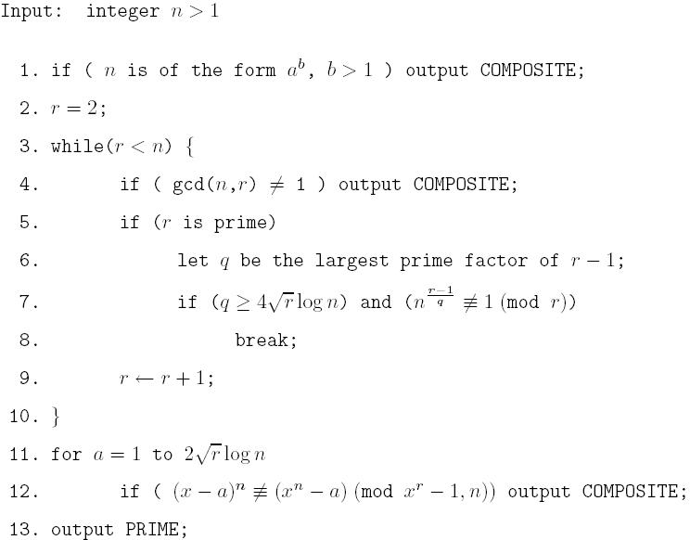
AKS Algorithm

Slide 7
Time Complexity of AKS
(1) Check for special case: O(log³n)
(2) while loop: O(log⁶n) iterations, each iteration takes r^{0.5}(log(logn)).
    →Total O((log⁶n)r^{0.5}) = O(log⁹n)
(3) for loop: using repeated squaring and Fast Fourier Multiplication, each iteration takes O((logn)r(logn))
  →Total O(r^{1.5}(log³n)) = O(log¹²n)

Slide 8
Related Analysis
A prime p is said to be a Sophie Germain prime if both p and 2p+1 are prime.
Conjecture: The number of co-Sophie Germain primes is asymptotic to Dx/log²(x), where D is the twin prime constant (estimated by Wrench and others to be approximately 0.6601618...).
If the conjecture above is true, then the time complexity of AKS can be lowered down to O(log⁶n)

